Slide 1
COMPUTER GRAPHICS
&
IMAGE PROCESSING
MODULE 4

Slide 2
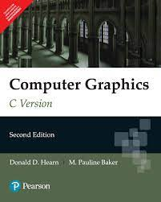
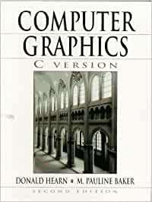
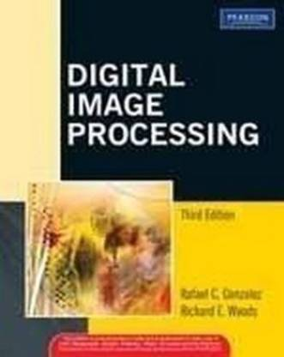

Slide 3
Module - 4 (Fundamentals of Digital Image Processing)
Introduction to Image processing and applications. Image as 2D data. Image representation in Gray scale, Binary and Colour images. Fundamental steps in image processing. Components of image processing system. Coordinate conventions. Sampling and quantization. Spatial and Gray Level Resolution. Basic relationship between pixels– neighborhood, adjacency, connectivity. Fundamentals of spatial domain-convolution operation.

Slide 4
What is an image?
An image is defined as a two-dimensional function,F(x,y), where x and y are spatial coordinates, and the amplitude of F at any pair of coordinates (x,y) is called the intensity of that image at that point.
When x,y, and amplitude values of F are finite, we call it a digital image.
In other words, an image can be defined by a two-dimensional array specifically arranged in rows and columns.
Digital Image is composed of a finite number of elements, each of which elements have a particular value at a particular location.
These elements are referred to as picture elements, image elements, and pixels.
A Pixel is most widely used to denote the elements of a Digital Image.

Slide 5
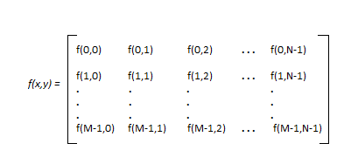
Image as Matrix

Slide 6
Image representation in Gray scale, Binary and Colour images
Binary Image
The binary image as it name states, contain only two pixel values ,0 and 1.
In our previous tutorial of bits per pixel, we have explained this in detail about the representation of pixel values to their respective colors.
Here 0 refers to black color and 1 refers to white color. It is also known as Monochrome.
Format
Binary images have a format of PBM ( Portable bit map )

Slide 7
8 bit color format (Gray Image)
8 bit color format is one of the most famous image format.
It has 256 different shades of colors in it.
It is commonly known as Grayscale image.
The range of the colors in 8 bit vary from 0-255.
Where 0 stands for black, and 255 stands for white, and 127 stands for gray color.
This format was used initially by early models of the operating systems UNIX and the early color Macintoshes.
Format
The format of these images are PGM ( Portable Gray Map ).
This format is not supported by default from windows. In order to see gray scale image, you need to have an image viewer or image processing toolbox such as Matlab.

Slide 8
16 bit color format
It is a color image format. It has 65,536 different colors in it. It is also known as High color format.
It has been used by Microsoft in their systems that support more then 8 bit color format.
Now in this 16 bit format and the next format we are going to discuss which is a 24 bit format are both color format.
The distribution of color in a color image is not as simple as it was in grayscale image.
A 16 bit format is actually divided into three further formats which are Red , Green and Blue. The famous (RGB) format.

Slide 9
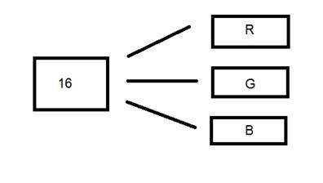
5 bits for R, 5 bits for G, 5 bits for B
Then there is one bit that remains in the end.
So the distribution of 16-bit has been done like this: 5 bits for R, 6 bits for G, and 5 bits for B.
The additional bit that was left behind is added into the green bit.
Because green is the color that is most soothing to the eyes in all of these three colors.

Slide 10
24 bit color format
24 bit color format also known as true color format.
Like 16 bit color format, in a 24 bit color format, the 24 bits are again distributed in three different formats of Red, Green and Blue.
Since 24 is equally divided on 8, so it has been distributed equally between three different color channels.
Their distribution is like this : 8 bits for R, 8 bits for G, 8 bits for B.
Format
It is the most commonly used format. Its format is PPM ( Portable pixMap) which is supported by Linux operating system. The famous windows have its own format for it which is BMP ( Bitmap ).

Slide 11
Digital Image Processing means processing digital images by means of a digital computer.
We can also say that it is a use of computer algorithms to get enhanced images or extract useful information.
Image processing and applications
1)Gamma-ray Imaging: In nuclear medicine injecting a patient with a radioactive isotope emits gamma rays as its decays. Images are collected from the emission collected by gamma-ray decoders. Images of this sort are used to locate sites of bone pathology such as infections or tumors.
Astronomical observations

Slide 12
2) X-ray Imaging
Medical diagnostics
Angiography
Computerized axial tomography (CT scan)
Industry applications
3) Ultraviolet Imaging
Lithography,
Industrial inspection,
microscopy,
lasers,
biological imaging,
astronomical observations.

Slide 13
4) Imaging in the visible and Infrared band
light microscopy
astronomy
remote sensing
industry
law enforcement (biometrics)
5)Imaging in the Microwave Band
Radar –collect data over virtually any region at any time , regardless of weather or ambient lighting conditions.

Slide 14
6) Imaging in the Radio Band
Medicine –magnetic resonance imaging (MRI)
Astronomy

Slide 15
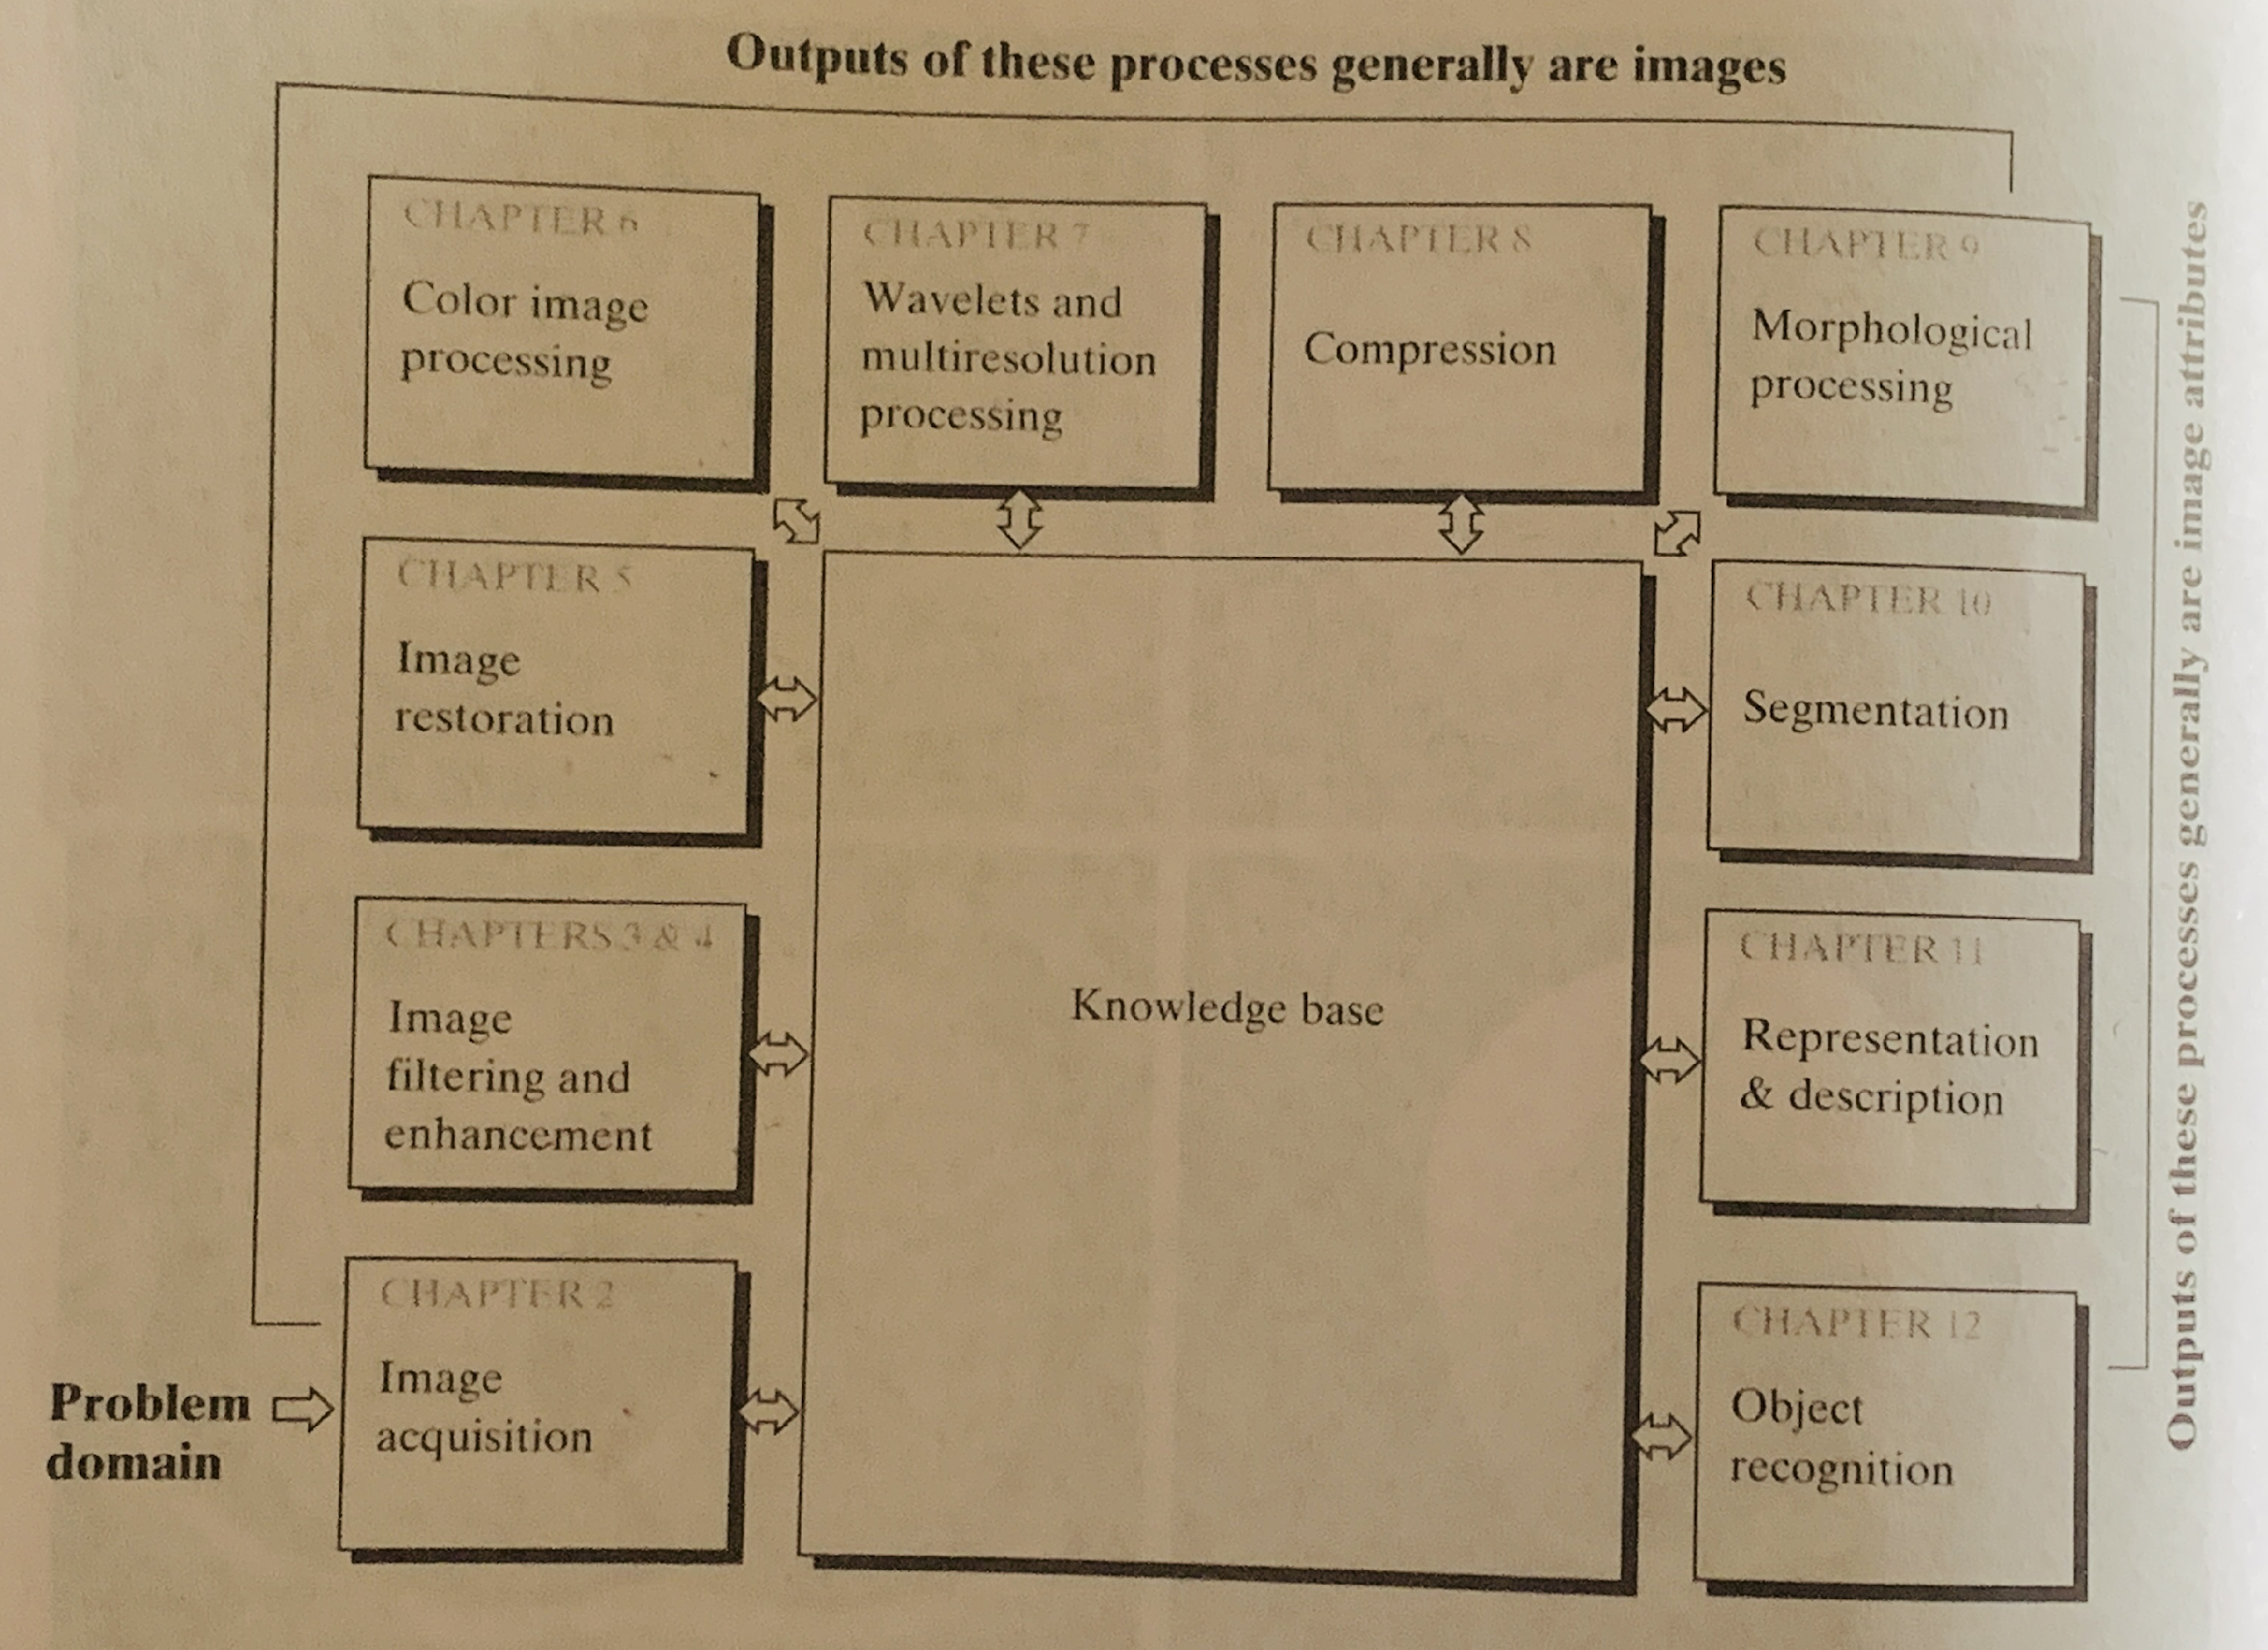
Fundamental Steps in Digital Image Processing
Knowledge base –all the information relating to an image for processing

Slide 16
1) Image Acquisition is the first step of the fundamental steps of DIP. In this stage, an image is given in digital form. Generally, in this stage, pre-processing such as scaling is done.
2) Image Enhancement is the process of manipulating an image so that the result is more suitable than the original for a specific application . Interesting features of an image is highlighted such as brightness, contrast, removal of noise ,sharpening of an image etc.Subjective in nature –vary from application to application .
3) Image Restoration is the stage in which the appearance of an image is improved. Recovering an image that has been degraded .Objective in nature .
4) Color Image Processing
Color image processing is a famous area because it has increased the use of digital images on the internet. This includes color modeling, processing in a digital domain, etc.

Slide 17
5) Wavelets and Multi-Resolution Processing
Wavelets help to wavelet transform ,that transformed form gives time and frequency information of an image .Wavelets leads to multi resolution processing in which image is represented in various degrees of resolution.
6) Compression
Compression is a technique which is used for reducing the requirement of storing an image. It is a very important stage because it is very necessary to compress data for internet use.
7) Morphological Processing
This stage deals with tools which are used for extracting the components of the image, which is useful in the representation and description of shape. Basic morphological operations are erosion and dialation .

Slide 18
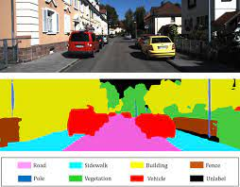
8) Segmentation
In this stage, an image is a partitioned into its objects. Segmentation is the most difficult tasks in DIP. It is a process which takes a lot of time for the successful solution of imaging problems which requires objects to identify individually.
Image Segmentation is the process by which a digital image is partitioned into various subgroups (of pixels) called Image Objects, which can reduce the complexity of the image, and thus analysing the image becomes simpler.

Slide 19
9) Representation and Description
Representation and description follow the output of the segmentation stage. The output is a raw pixel data which has all points of the region itself or constituting either the boundary of a region . To transform the raw data, representation is the only solution.
Converting the data to a form suitable for computer processing is necessary .
Whereas description is used for extracting information's to differentiate one class of objects from another. It is the feature selection that deals with extracting attributes that result in some quantitative information of interest .
10) Object recognition
In this stage, the label is assigned to the object, which is based on descriptors.

Slide 20
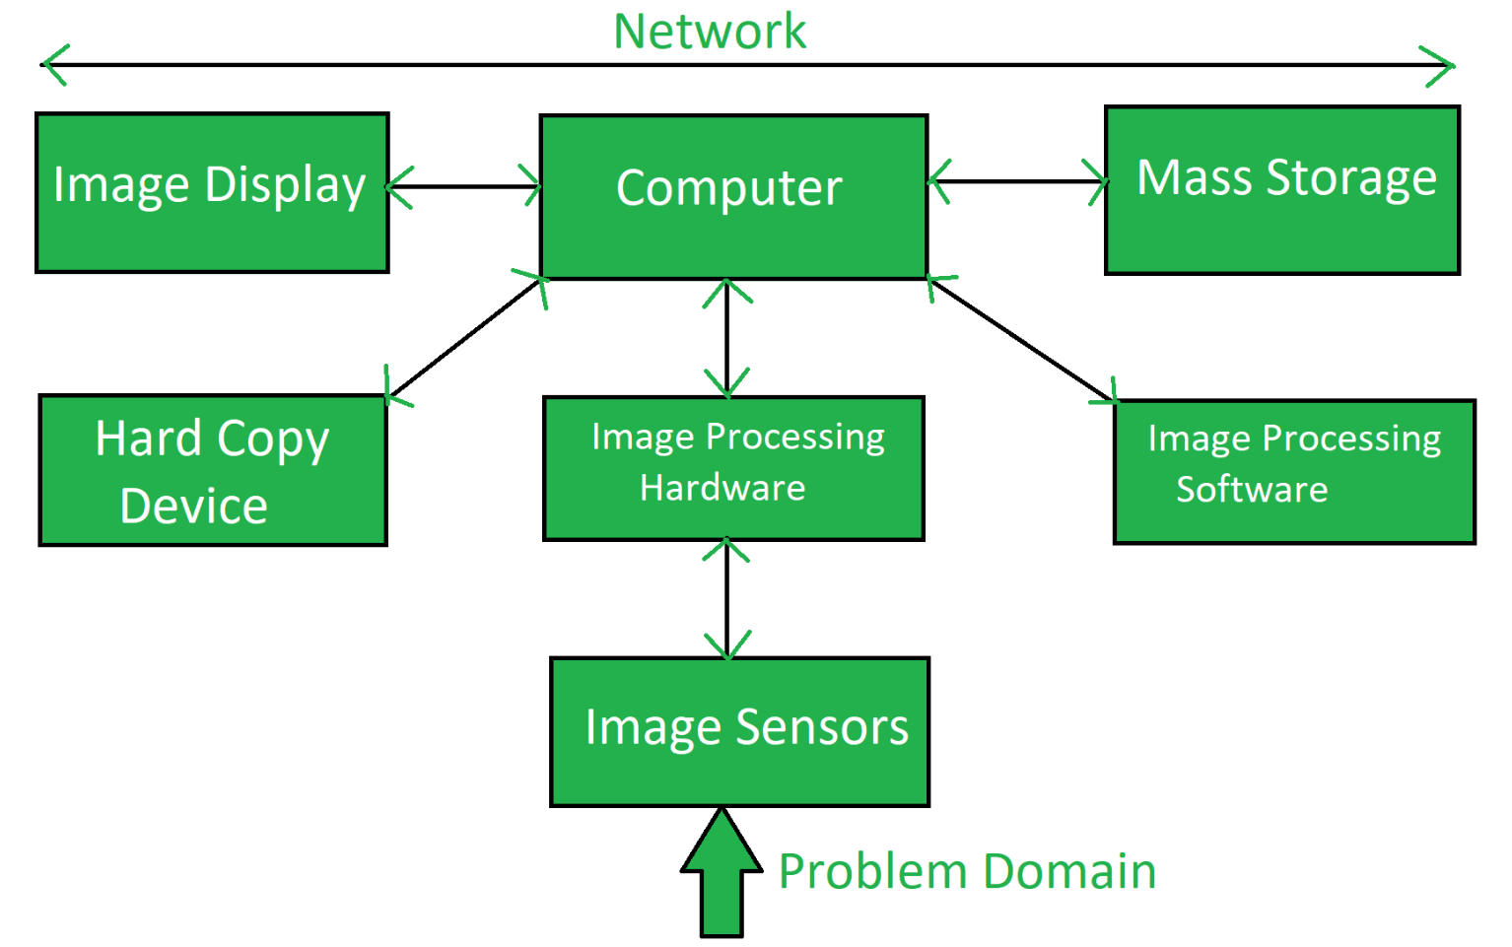
Components of image processing system.

Slide 21
Image Sensors: Two elements are required to acquire digital images,the first is a physical device that is sensitive to the energy radiated by the object we wish to image. The second is a digitizer, which is a device for converting the output of the physical sensing device into digital form.
Specialized Image Processing Hardware: Consists of the digitizer plus hardware that performs other primitive operations, such as an ALU that performs parallel arithmetic and logic operations on entire images.
Computer: The computer used in the image processing system is the general-purpose computer that is used by us in our daily life. It can range from a PC to a supercomputer. Sometimes custom computers are used to achieve a required level of performance.

Slide 22
Image Processing Software: Image processing software is software that includes all the mechanisms and algorithms that are used in the image processing system.
Mass Storage: Mass storage stores the pixels of the images during the processing. An image of size 1024 x 1024 pixels, in which the intensity of each pixel is an 8-bit quantity, requires 1 MB of storage space if the image is not compressed. Providing adequate storage in an image processing system can be a challenge.
Digital storage for image processing applications falls into three principal categories :
1)Short-term storage for use during processing
2) Online storage for relatively fast recall
3)Archival storage for infrequent access.

Slide 23
Image Display: mainly color TV monitors, in some cases, there are stereo displays and these are implemented in the form of headgear containing two small displays embedded in goggles worn by the user.
Hard Copy Device: Once the image is processed then it is stored in the hard copy device. It can be a pen drive or any external ROM device.
Use laser printers, film cameras, and optical and CD ROM disks.
Network:
Because of the large amount of data inherent in image processing applications, the key consideration in image transmission is bandwidth.

Slide 24
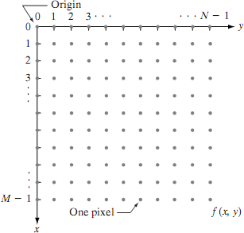
Coordinate conventions.
The size of the image is the number of rows by the number of columns M x N .

Slide 25
Sampling and quantization
Conversion of analog signal to digital signal:
The output of most of the image sensors is an analog signal, and we can not apply digital processing to it because we can not store it. We can not store it because it requires infinite memory to store a signal that can have infinite values.
So we have to convert an analog signal into a digital signal .
To create an image which is digital, we need to covert continuous data into digital form. There are two steps in which it is done.
Sampling
Quantization

Slide 26
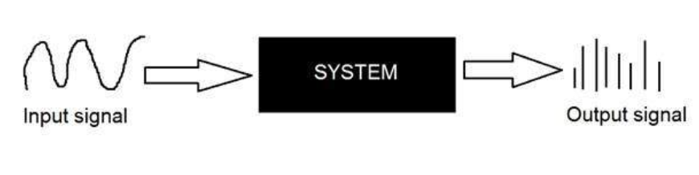
Basic Idea :Converting an analog signal to digital form
convert both of its axis (x,y) into a digital format.

Slide 27
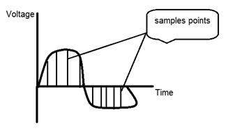
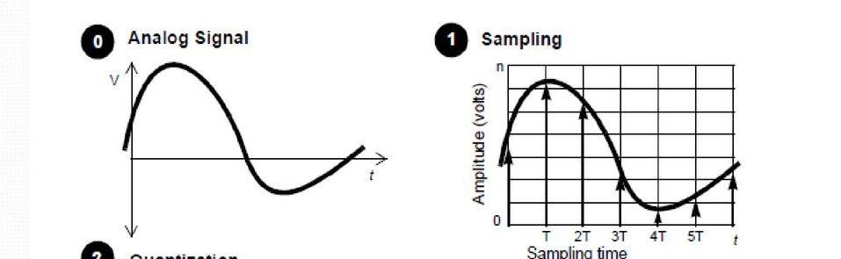
Sampling
Digitize x-axis in the sampling
It is done on the independent variable.
In case of equation y = sin(x), it is done on x variable

Slide 28
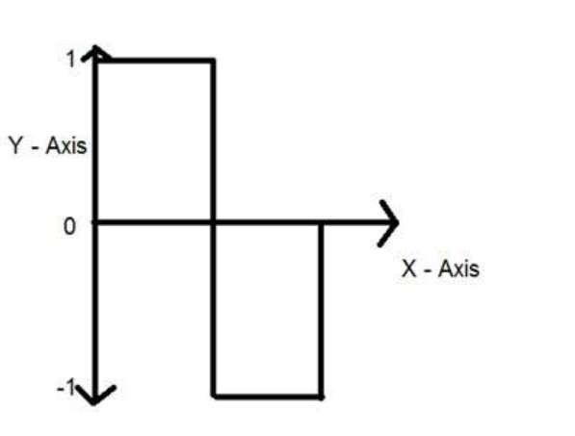
Quantization
Quantization is the opposite of sampling. It is done on y-axis. When you are quantizing an image, you are actually dividing a signal into quanta(partitions).
On the x-axis of the signal, are the coordinate values, and on the y axis, we have amplitudes. So digitizing the amplitudes is known as Quantization.
The signal has been quantified into three different levels.

Slide 29
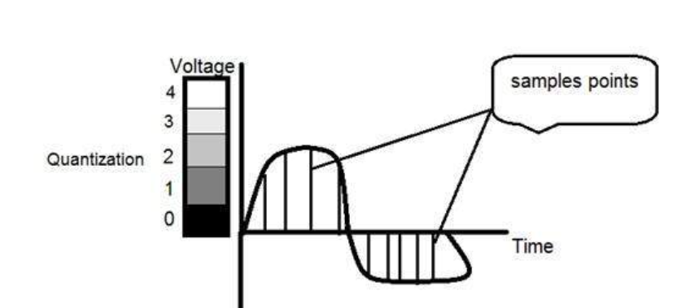
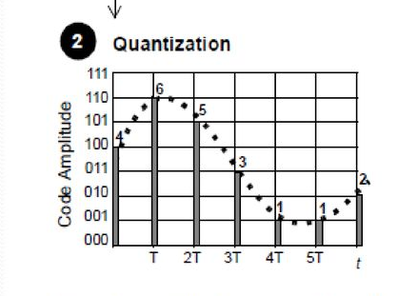
Signal has been quantized into 5 different levels or partitions. Ranging from 0 black to 4 white.
when we sample an image, we actually gather a lot of values along x-axis , and in quantization, we set different intensity levels to these x-sample values.

Slide 30

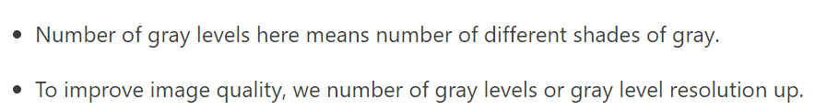

Slide 31
Spatial and Gray Level Resolution
Spatial resolution states that the clarity of an image cannot be determined by pixel resolution (number of pixels in an image).
Spatial resolution can be defined as the number of independent pixels values per inch.

Slide 32
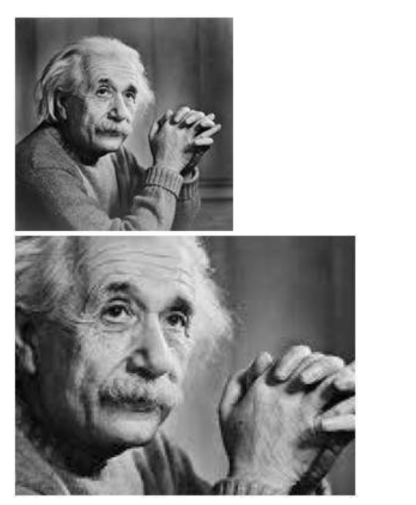
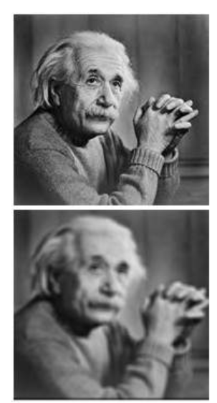

Slide 33
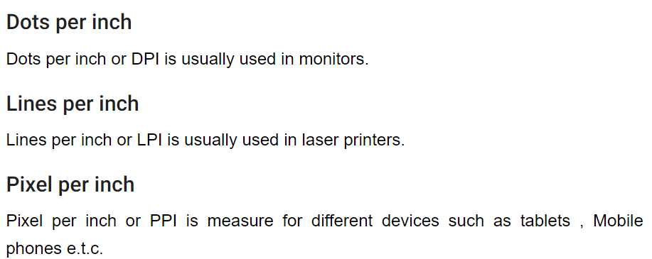

Slide 34

Gray level resolution
Gray level resolution refers to the predictable or deterministic change in the shades or levels of gray in an image.
In short gray-level resolution is equal to the number of bits per pixel (BPP).
The number of different colors in an image depends on the depth of color or bits per pixel.
The mathematical relation that can be established between gray level resolution and bits per pixel can be given as.
L – number of gray levels
K-bits per pixel

Slide 35
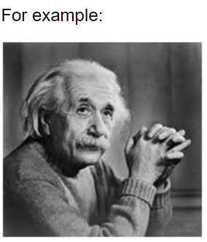
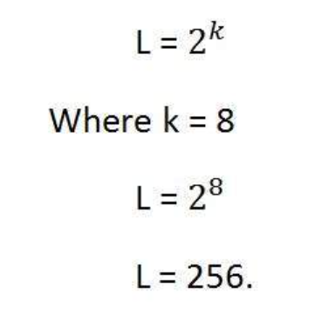
The image of Einstein is a grayscale image
It is an image with 8 bits per pixel or 8bpp.
Gray-level resolution =
It means its gray-level resolution is 256. Or in another way, we can say that this image has 256 different shades of gray.
The more the bits per pixel of an image, the more is its gray-level resolution.

Slide 36
The spatial resolution of an image is given by 128 X 128. What is its storage requirements if it is represented by 64 gray levels?
64=2⁶
6-bit representation for each grey level.
Image size =128 x128
Storage requirements=128 x128 x6 bits

Slide 37
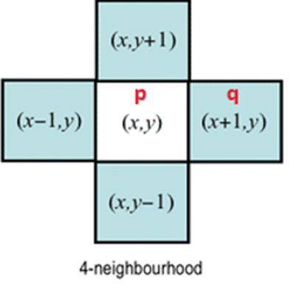
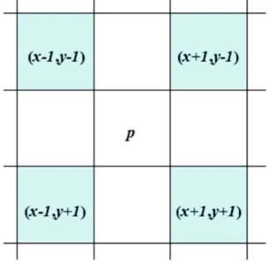
The basic relationship between pixels– neighborhood, adjacency, connectivity
Neighbors of a Pixel
A pixel p at coordinates (x,y) has four horizontal and vertical neighbors whose coordinates are given by: (x+1,y),(x-1,y), (x,y+1), (x,y-1) .
This set is called the 4-neighbors of p, is denoted by N₄(P). Each pixel is a unit distance from (x,y), and some of the neighbor locations of p lie outside the digital image if (x,y) is on the border of the image.
The four-diagonal neighbor of p have coordinates: (x+1,y+1),(x+1,y-1), (x-1,y+1), (x-1,y-1) and are denoted by N_{D}(P).

Slide 38
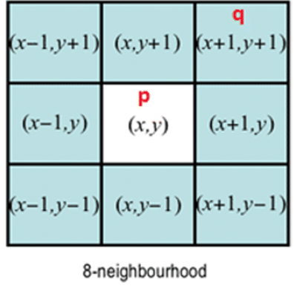
N_{D}(P) together with N₄(P) are called the 8-neighbors of p, denoted by N₈(P).
N8 = N4 U ND
Some of the points in the N4 , ND, and N8 may fall outside the image when P lies on the border of an image.

Slide 39
Adjacency: Two pixels are connected if they are neighbors, and their gray levels satisfy some specified criterion of similarity.
For example, in a binary image two pixels are connected if they are 4-neighbors and have the same value (0/1) .
Let v: a set of intensity values used to define adjacency and connectivity.
In a binary Image v={1}, if we are referring to adjacency of pixels with value 1.
In a Gray scale image, the idea is the same, but v typically contains more elements,
for example v= {180, 181, 182,....,200}.
If the possible intensity values 0 to 255, v set could be any subset of these 256 values.

Slide 40
Types of adjacency/connectivity
1. 4-adjacency: Two pixels p and q with values from v are 4-adjacent if q is in the
set N4 (p).
2. 8-adjacency: Two pixels p and q with values from v are 8-adjacent if q is in the
set N8 (p).
3. m-adjacency (mixed): two pixels p and q with values from v are m-adjacent if:
q is in N4 (p) or
q is in ND (P) and the set N4 (p) ∩ N4 (q) has no pixel whose values are from V.
Mixed adjacency is a modification of 8-adjacency ''introduced to eliminate the ambiguities that often arise when 8- adjacency is used. (eliminate multiple path connection)

Slide 41
4 adjacency
Binary Image
Gray Image
0 | 1 | 0 | 1
0 | 0 | 1 | 0
0 | 0 | 1 | 0
1 | 0 | 0 | 0
54 | 10 | 100 | 8
81 | 150 | 2 | 34
200 | 201 | 3 | 45
7 | 70 | 147 | 56
v={1}
v={1,2,3,4,5,6,7,8,9,10}

Slide 42
8 adjacency
Binary Image
Gray Image
0 | 1 | 0 | 1
0 | 0 | 1 | 0
0 | 0 | 1 | 0
1 | 0 | 0 | 0
54 | 10 | 100 | 8
81 | 150 | 2 | 34
200 | 201 | 3 | 45
7 | 70 | 147 | 56
x
x
v={1}
v={1,2,3,4,5,6,7,8,9,10}

Slide 43
m adjacency
If 4 adjacency and 8 adjacency are possible at the same time priority is for 4 adjacency
Binary Image
Ambiguity
0 | 1 | 1
0 | 1 | 0
0 | 0 | 1
0 | 1 | 1
0 | 1 | 0
0 | 0 | 1
v={1}

Slide 44
A digital path or curve from a pixel p with coordinates(x,y) to pixel q with coordinates
(s,t) is a sequence of distinct pixels with coordinates
(x0,y0),(x1,y1),…,(xn,yn) where (x0,y0)=(x,y) and (xn,yn)=(s,t) and pixels (xi,yi) and (xi-1,yi-1) are adjacent for 1<=i<=n . Here length of the path=n.
If (x0,y0)=(xn,yn) ,the path is a closed path .
We can define 4- , 8- , or m- paths depending on the type of adjacency.

Slide 45
m adjacency
8-paths
p
v={1}
0 | 1 | 1
0 | 1 | 0
0 | 0 | 1
m-paths
0 | 1 | 1
0 | 1 | 0
0 | 0 | 1

Slide 46
Define 4-adjacency, 8-adjacency and m-adjacency. Consider the image segment shown.
Let V={1,2} and compute the length of the shortest 4- ,8- and m- path between p and q. If a particular path does not exist between these two points, explain why?
4 | 2 | 3 | 2
3 | 3 | 1 | 3
2 | 3 | 2 | 2
2 | 1 | 2 | 3
q
p
4- path between q and p is not possible, because q has no 4 adjacent pixels with values 1 or 2.
q
4 | 2 | 3 | 2
3 | 3 | 1 | 3
2 | 3 | 2 | 2
2 | 1 | 2 | 3
8- path between q and p is possible,
Length =4
p

Slide 47
m- path between q and p is possible,
q
4 | 2 | 3 | 2
3 | 3 | 1 | 3
2 | 3 | 2 | 2
2 | 1 | 2 | 3
Length=5
p

Slide 48
Let S represent a subset of pixels in an image. Two pixels p and q are said to be connected in S if there exists a path between them consisting entirely of pixels in S.
For any pixel p in S, the set of pixels that are connected to p in S is called a connected
component of S.
If it only has one connected component, then set S is called a connected set.
There are three types of connectivity on the basis of adjacency. They are:
a) 4-connectivity: Two or more pixels are said to be 4-connected if they are 4-adjacent with each others.
b) 8-connectivity: Two or more pixels are said to be 8-connected if they are 8-adjacent with each others.
c) m-connectivity: Two or more pixels are said to be m-connected if they are m-adjacent with each others.

Slide 49
Connected components of an image

Slide 50
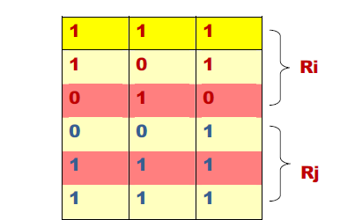
Region
· Let R to be a subset of pixels in an image, we call R a region of the image. If R is a connected set.
Two regions Ri,Rj are said to be adjacent if their union forms a connected set .
Regions that are not adjacent are said to be disjoint.
Two regions (of 1s) in the figure, are adjacent only if 8-adjacency is used.
4-path between the two regions does not exist, (so their union in not a connected set).

Slide 51
Boundary
Set of pixels in the region that have one or more neighbors that are not in the region.
Suppose that an image contains K distinct regions,Rk,k=1,2,3,…k, none of which touches the image border.
Let Ru denote the union of all the K regions , and let (Ru)^{c}
denote its complement ( complement of a set S is the set of points that are not in S) .
We call all the points in Ru the foreground and all the points in (Ru)c the background of the image.
The boundary of a region R is the set of pixels in the region that has at least one background neighbor.

Slide 52
0 | 0 | 0 | 0 | 0
0 | 1 | 1 | 0 | 0
0 | 1 | 1 | 0 | 0
0 | 1 | 1 | 1 | 0
0 | 1 | 1 | 1 | 0
0 | 0 | 0 | 0 | 0
The pixel circled in the figure is not a member of the border of the 1-valued region if 4 –connectivity is used between the region and its background.
The circled point is part of the boundary of the 1-valued pixels only if 8-adjacency between the region and background is used.
The inner border does not form a closed path around the region.
The outer border of the region does form a closed path around the region.

Slide 53
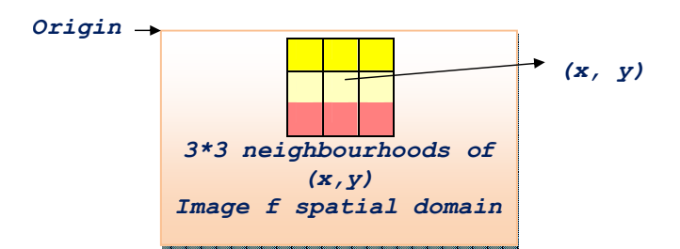
Fundamentals of spatial domain-convolution operation
Spatial Filtering
The mechanics of spatial filtering spatial filters consist of
1. Neighborhood (small rectangle).
2. Predefined operation that is performed on the image pixel.

Slide 54
Filtering creates new pixels with coordinates equal to the coordinates of the center of the neighborhood, and whose value is the result of the filtering operation.
If the operation performed on the image pixel is linear, then the filter is called a linear spatial filter, otherwise, the filter is nonlinear.
Mechanism of linear spatial filtering using a 3*3 neighborhood
The response (output) g(x,y) of the filter at any point (x,y) in the image is the sum of the products of the filter coefficients and the image pixels values:

Slide 55
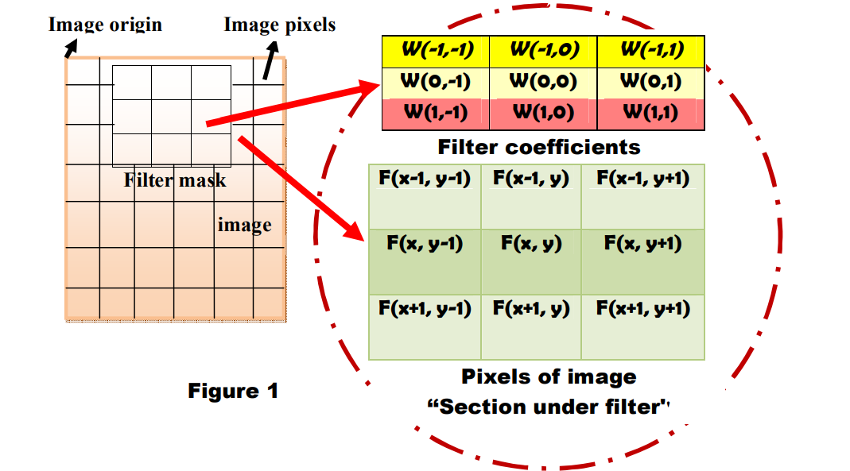

Slide 56
Observe that the center coefficient of the filter, w(O, O) aligns with the pixel at location(x, y).
g(x, y) = w(−1, −1)f(x − 1, y − 1) + w(−1, O)f(x − 1, y) +… + w (O, O) f(x, y) +
. . . + w(1, 1) f(x + 1, y + 1)
General mask of size m x n
Assume
m=2a+1 and n=2b+1 ,where a,b are positive integers
In general, linear spatial filtering of an image of size M ∗ N with a filter of size m ∗ n is given by the expression:

Slide 57
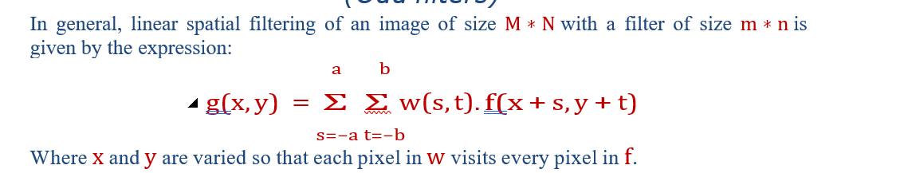
Spatial Correlation and convolution
Correlation and convolution are functions of displacement .
Correlation: the process of moving a filter mask over the image and computing the sum of products at each location.
Convolution: the same process as correlation, except that the filter is first rotated by 180^{O}

Slide 58
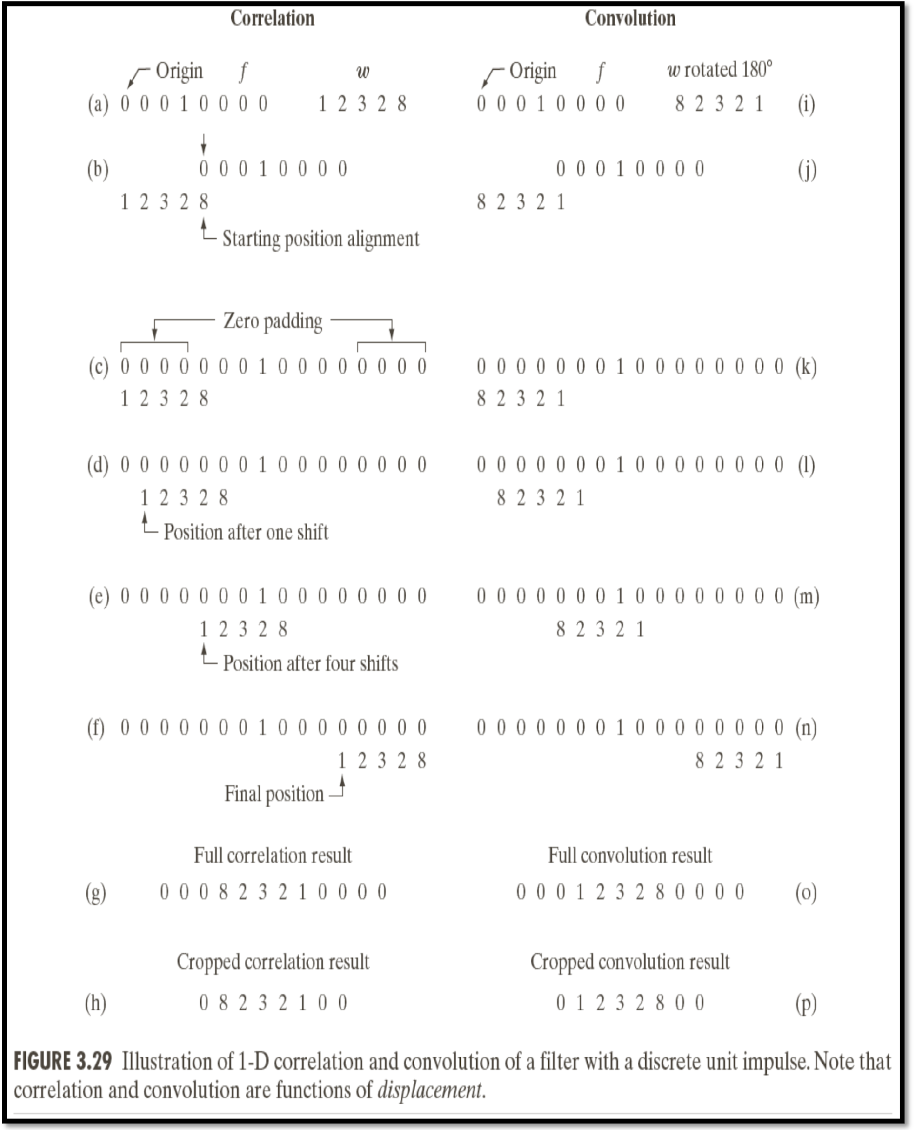

Slide 59
Assume that f is a 1-D function, and w is a filter
There are parts of the functions (images) that do not overlap (the solution of this problem is pad f with enough 0s on either side to allow each pixel in w to visit every pixel in f.
If the filter is of size m, we need (m-1) 0s on either side of f.
The first value of correlation is the sum of products of f and w for the initial position (The sum of product =0) this corresponds to a displacement x =0 .
To obtain the second value of correlation, we shift w are pixel location to the right (displacement x=1) and compute the sum of products (result =0).
The first nonzero is when x=3, in this case the 8 in w overlaps the 1 in f and the result of correlation is 8.

Slide 60
The full correlation result (figure 2.g) ,12 values of x.
To work with correlation arrays that are the same size as f, in this case, we can crop the full correlation to the size of the original function. (Figure 2.h).
The result of correlation is a copy of w, but rotated by 18O^{O .}
The correlation with a function with a discrete unit impulse yields a rotated version of the function at the location of the impulse.
The convolution with a function with a discrete unit impulse yields a copy of that function at the location of the impulse.

Slide 61
Correlation and convolution with images
With a filter of size m*n, we pad the image with a minimum of m-1 rows of 0s at the top and the bottom, and n-1 columns of 0s on the left and right.
If the filter mask is symmetric, correlation and convolution yield the same result.

Slide 62
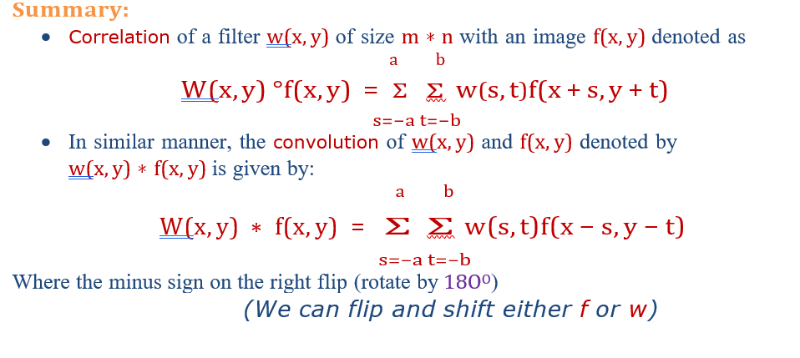

Slide 63
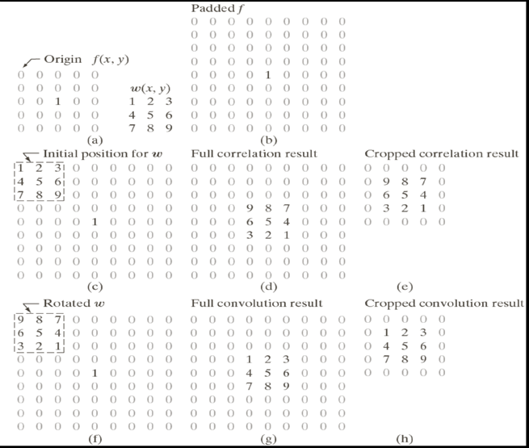

Slide 64
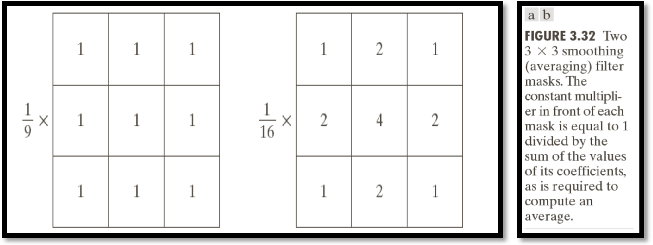
Examples of filter masks

